Slide 1

Openstack projects overview
Main services
Notes:
已commits从公司、个人的贡献，projects数量说明现状

Slide 2
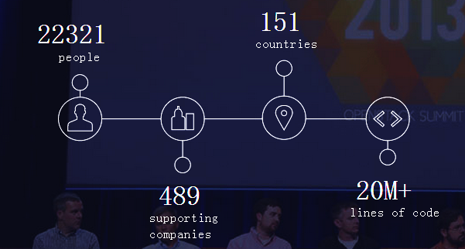
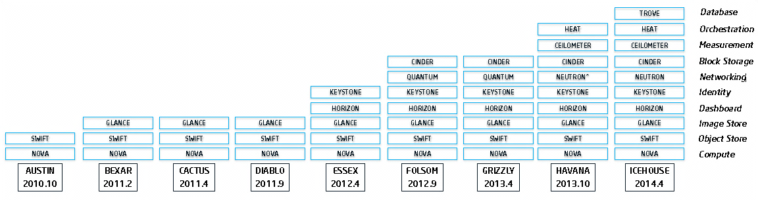
Openstack evolution
Notes:
juno

Slide 3
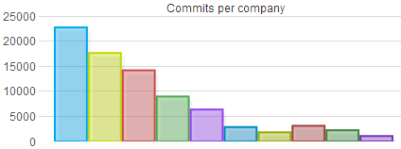
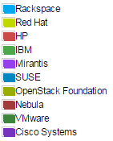
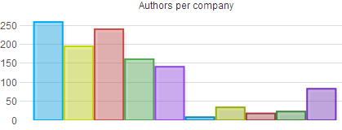
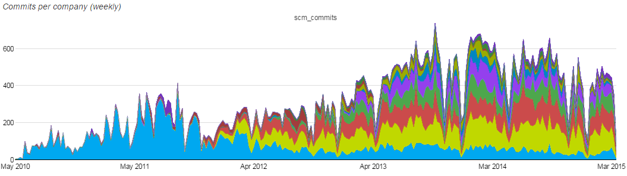
Companies analysis

Slide 4
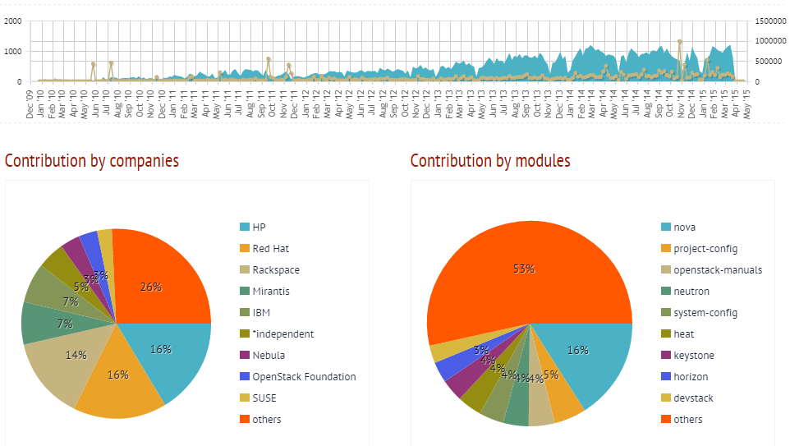
Companies analysis
Notes:
LOC: 15113112
Commits: 113539
Developers: 3135
Tickets: 59091

Slide 5
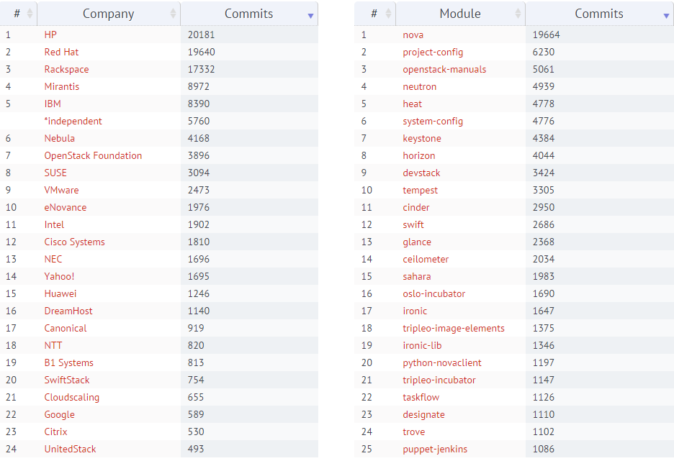
Companies commits

Slide 6
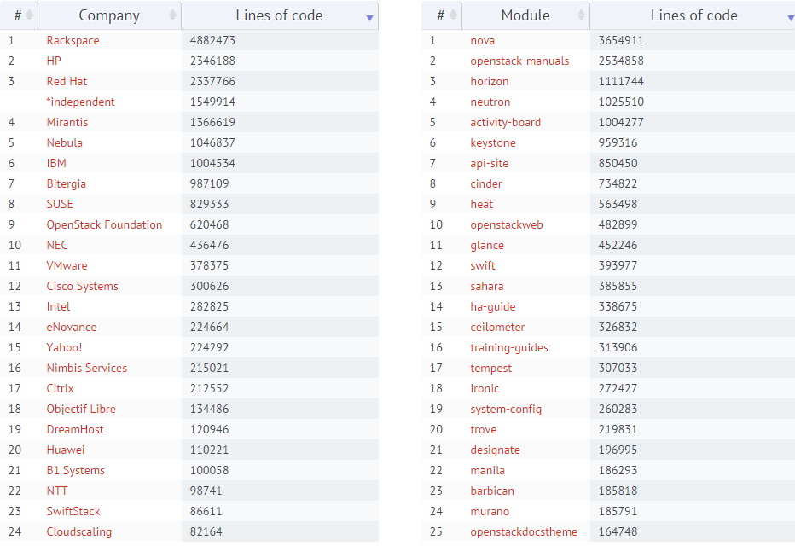
Lines of code

Slide 7
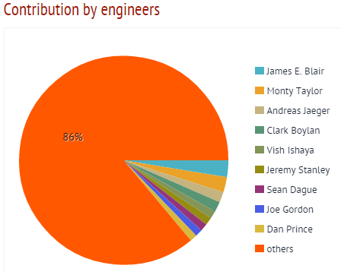
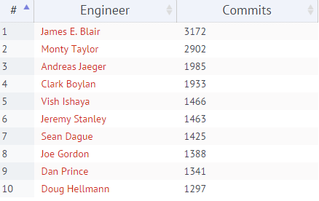
Contribution by engineers
Notes:
HP

Slide 8
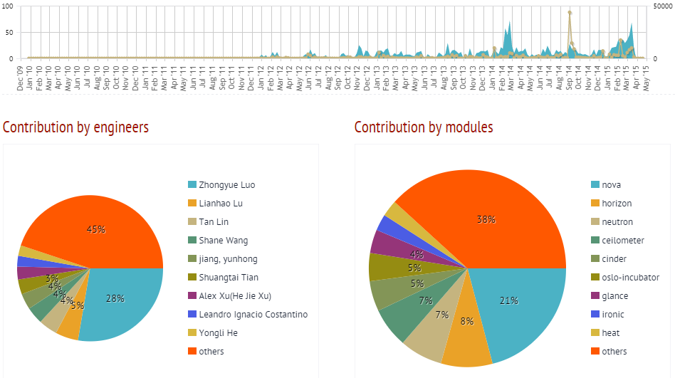
Contribution of Intel by commits

Slide 9
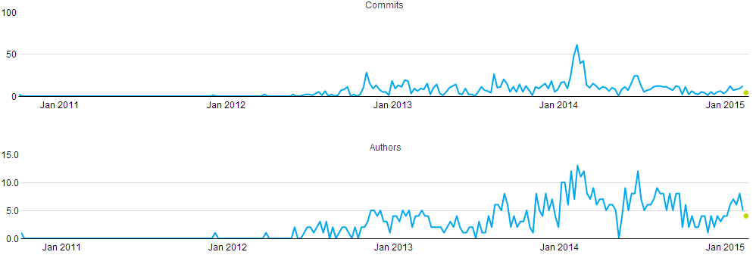
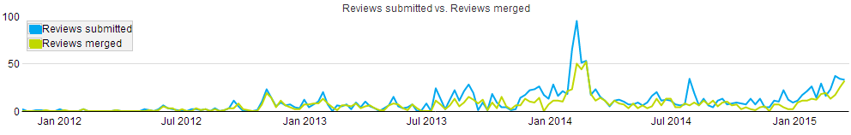
Activity of Intel

Slide 10
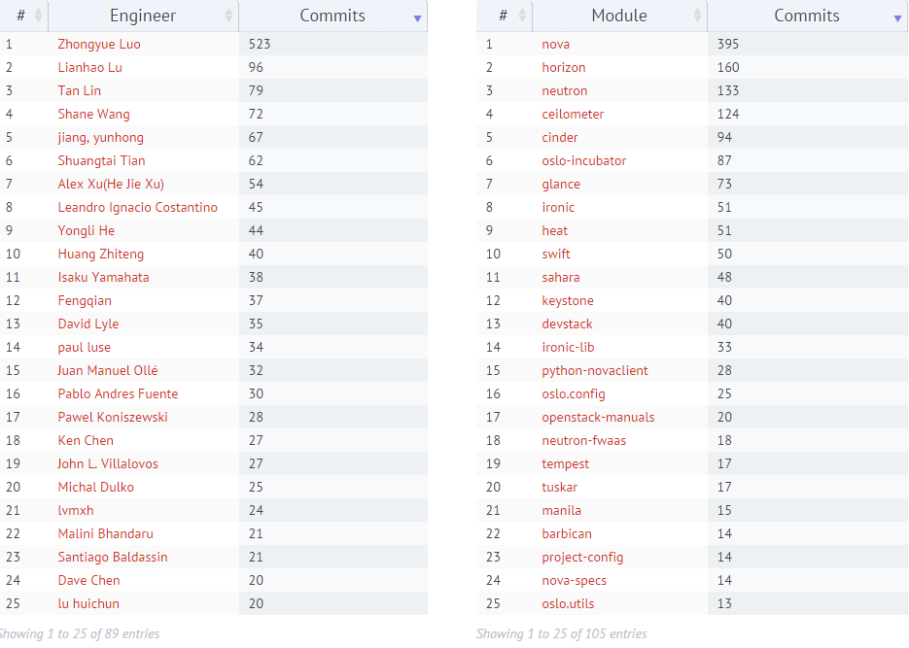
Contribution of Intel by commits

Slide 11
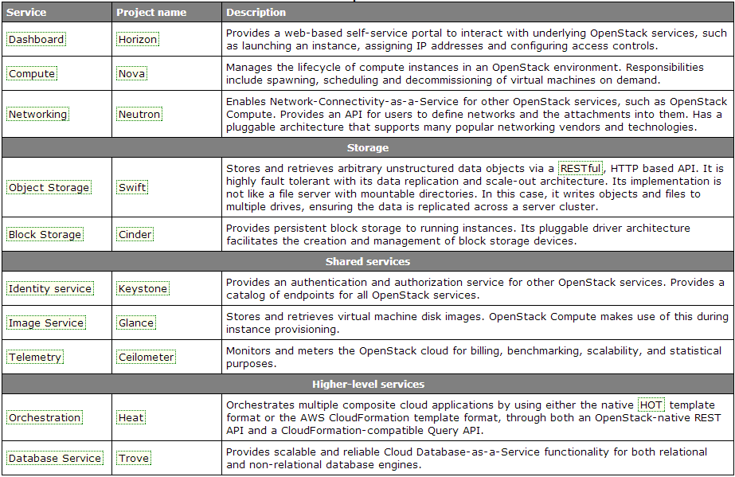
OpenStack services

Slide 12
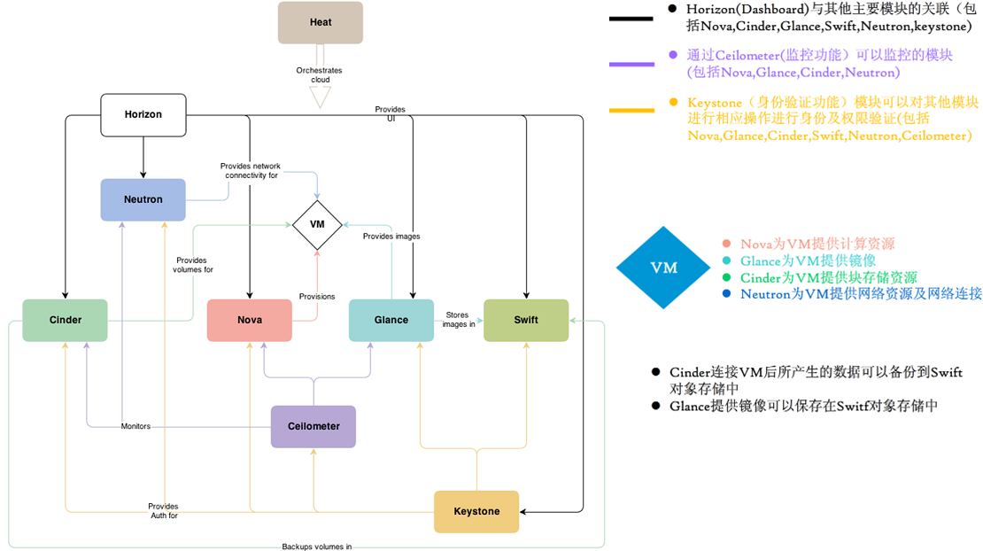
Conceptual architecture
Notes:
可以根据业务需要通过 Heat 组件订制出模板, 用户在经 KeyStone 模块授权后（Provide Auth），通过 Horizon 或 RestAPI 模式创建虚拟机服务。创建过程包括了利用 Nova 模块创建虚拟机实例（VM Provision），该 VM 采用了 Glance 模块提供的镜像服务（Provide Image），然后用 Neutron 模块为新建的 VM 分配 IP 地址，把其纳入到虚拟网络中（Provide network connectivity），之后再通过 Cinder 模块创建的 Volume 为 VM 挂载存储块。整个过程都在 Cellometer 模块的资源监控下（Monitors)，Cinder 产生的 Volume 和 Glance 提供的 Image 可以通过 Swift 的对象存储机制进行保存。
OpenStack 云平台服务的提供主要是依靠 Nova、Glance、Cinder 和 Neutron 四个核心模块完成的，相对四个辅助模块 Horizon、Cellometer、Keystone、Swift 提供的访问、监控、权限和对象存储功能

Slide 13
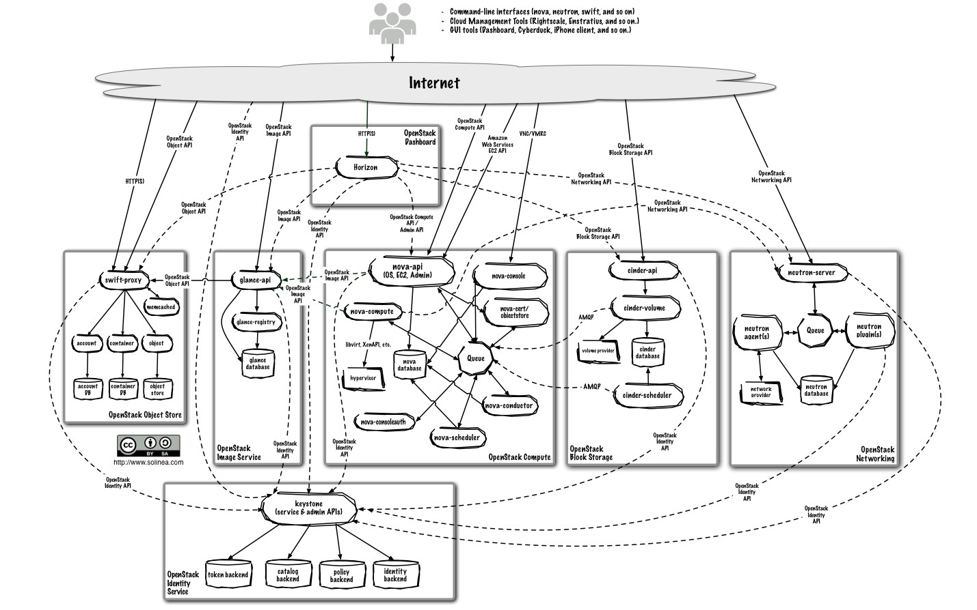
Logical architecture

Slide 14
Keystone
Identity service
Provides 3A(Account, Authentication, Authorization) services.
Supports token-based authN and user-service authorization.
Integrate with LDAP
Suppot oAuth, SAML and openID in future versions.
Notes:
Keystone为所有的OpenStack组件提供认证、授权、访问策略管理服务、目录服务，这些服务包括注册所有租户和用户，它依赖自身REST（基于Identity API）系统进行工作。
身份管理系统的核心对象是用户。
租户可以表示一个客户、帐户或者任何组织单位。是各个服务中一些可以访问资源集合，在Nova中可以是一些机器，在swift和Glance中可以是一些机器，在neutron中可以是一些网络资源。
http://docs.openstack.org/developer/keystone/

Slide 15
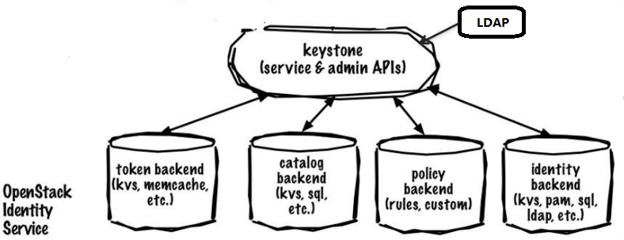
Architecture

Slide 16
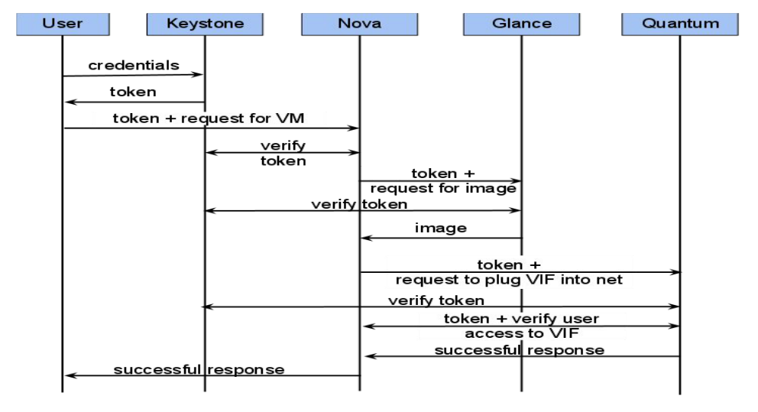
Work flow

Slide 17
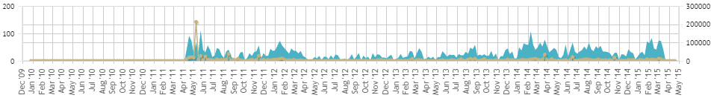
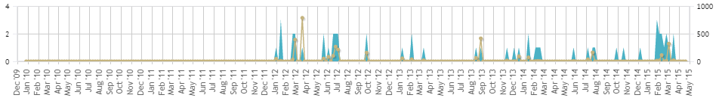
Keystone

Slide 18
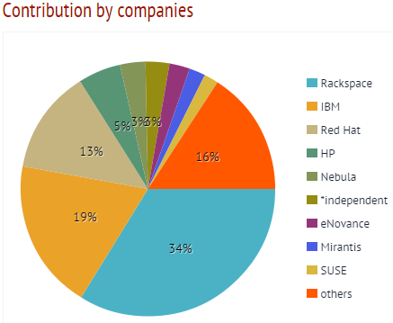
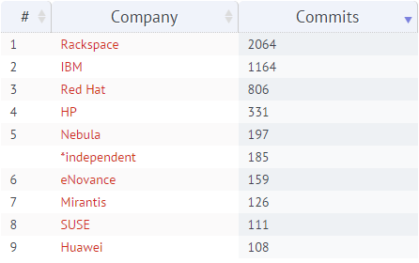
Contribution by companies

Slide 19
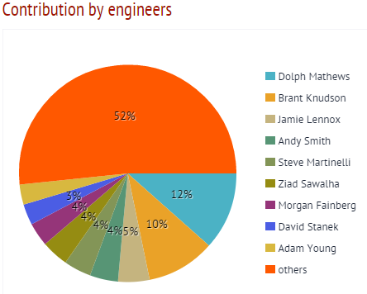
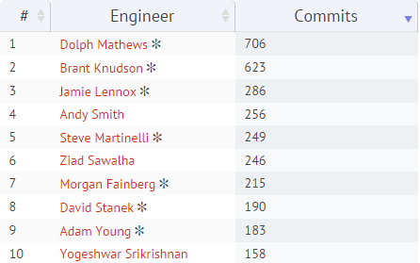
Contribution by engineers

Slide 20
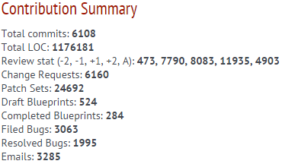
Contribution Summary

Slide 21
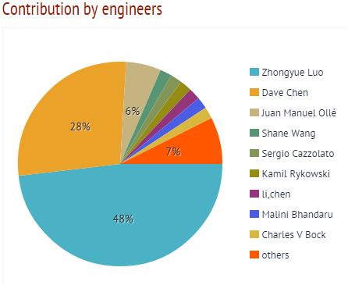
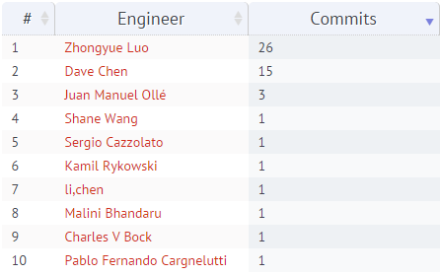
Contribution of Intel

Slide 22
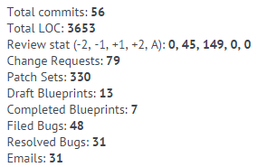
Contribution Summary

Slide 23
Nova
A cloud computing fabric controller, the main part of an IaaS system.
Manage virtualized commodity server resources.
Virtual Machine management.
Manage Local Area Networks (LAN)
API with rate limiting and authentication
Distributed and asynchronous architecture
Virtual Machine (VM) image management
Live VM management
Floating IP addresses
Role Based Access Control (RBAC)
Notes:
控制云计算架构，云计算控制器，是基础架构服务核心, 模块主要负责云虚拟机实例的生成、监测、终止等管理功能。
支持各种虚拟化技术，包括KVM, Xen, LXC， Vmware，除了本身的API还支持Amazon EC2 和 S3 APIs。
使用message queue通信，non-blocking。
http://docs.openstack.org/developer/nova/
http://docs.openstack.org/admin-guide-cloud/content/logical-architecture.html

Slide 24
Hypervisors
Baremetal
Docker
Hyper-V
Kernel-based Virtual Machine (KVM)
Linux Containers (LXC)
Quick Emulator (QEMU)
User Mode Linux (UML)
VMware vSphere
Xen
Notes:
libvirt

Slide 25
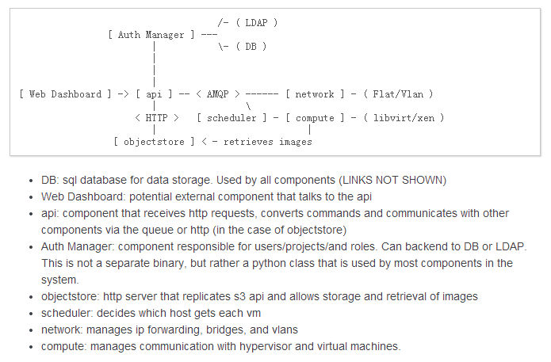
Components

Slide 26
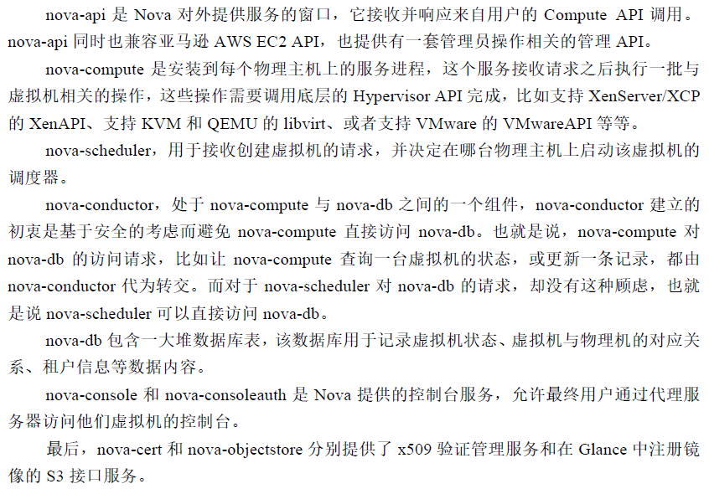
Components

Slide 27
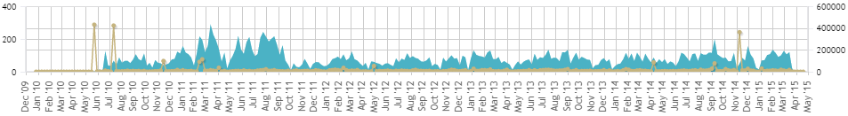
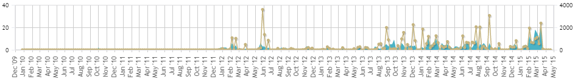
Nova

Slide 28
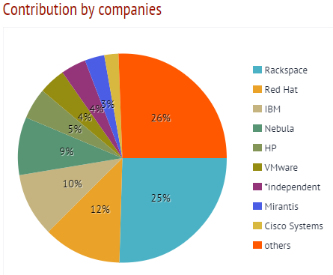
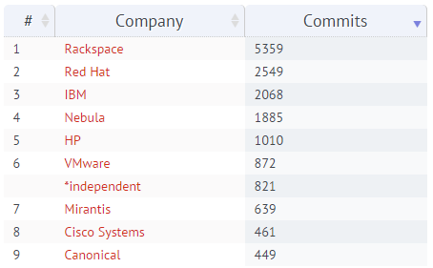
Contribution by companies

Slide 29
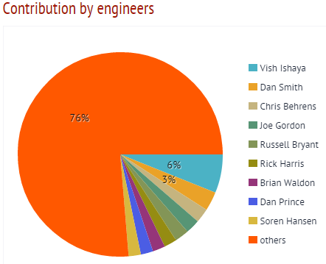
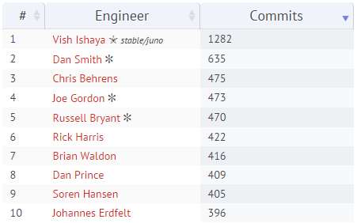
Contribution by engineers

Slide 30
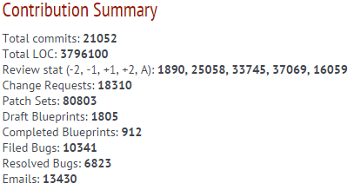
Contribution Summary

Slide 31
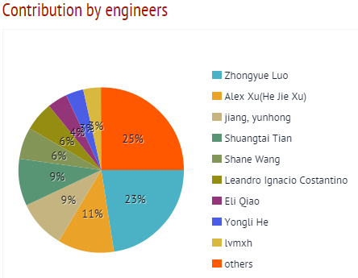
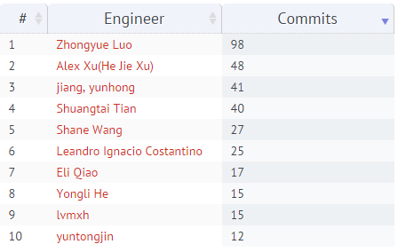
Contribution of Intel

Slide 32
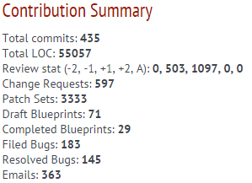
Contribution Summary

Slide 33
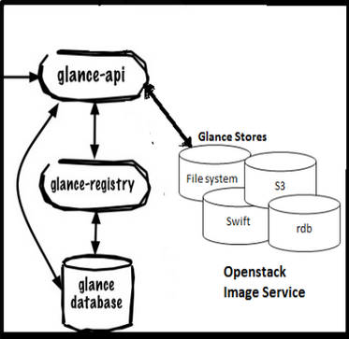
Glance
glance-api : It accepts Image API calls for image discovery, image retrieval and image storage.
glance-registry : it stores, processes and retrieves metadata about images (size, type, etc.).
glance database : A database to store the image metadata.
A storage repository for the actual image files. Glance supports normal filesystems, RADOS block devices, Amazon S3, HTTP and Swift.
Notes:
主要提供一个虚拟机镜像的存储、查询和检索服务，为Nova的虚拟机提供镜像服务。
http://docs.openstack.org/developer/glance/

Slide 34
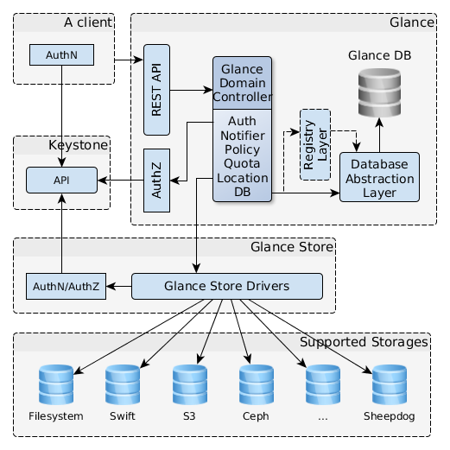
Architecture
Notes:
A client — any application that uses Glance server.
REST API — exposes Glance functionality via REST.
Database Abstraction Layer (DAL) — an application programming interface which unifies the communication between Glance and databases.
Glance Domain Controller — middleware that implements the main Glance functionalities: authorization, notifications, policies, database connections.
Glance Store — organizes interactions between Glance and various data stores.
Registry Layer — optional layer organizing secure communication between the domain and the DAL by using a seperate service.

Slide 35
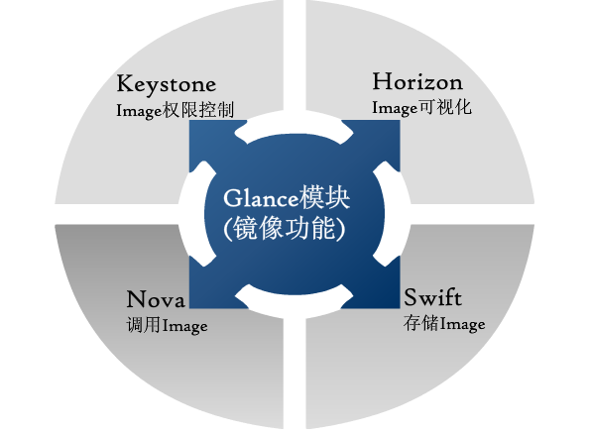
Glance in Openstack

Slide 36
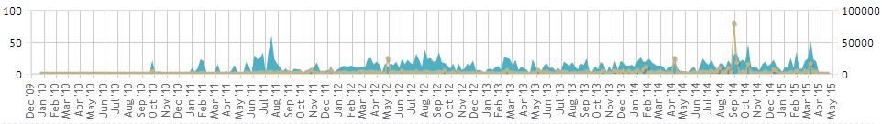
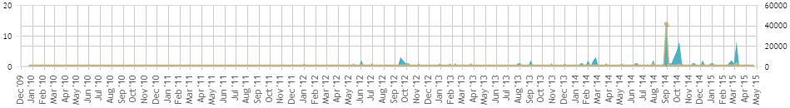
Glance

Slide 37
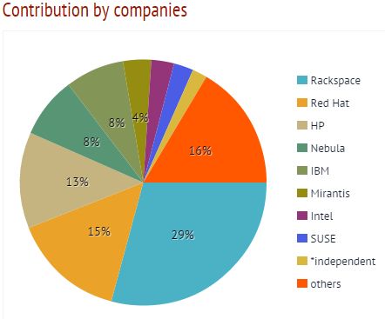
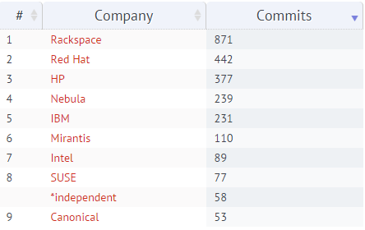
Contribution by companies

Slide 38
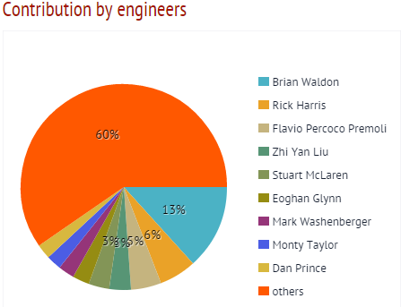

Contribution by engineers

Slide 39

Contribution Summary

Slide 40


Contribution of Intel

Slide 41

Contribution Summary

Slide 42
Neutron
A cloud computing network fabric controller
Define network connectivity and addressing.
Dynamically request and configure virtual networks
Notes:
提供云计算环境下的虚拟网络连接服务，允许用户创建自己的虚拟网络并连接各种网络设备接口。
现已由之前的 Quantum 改名为 Neutron
支持多种物理网络类型，支持 Linux Bridge、Hyper-V 和 OVS bridge 计算节点共存
支持防火墙服务
节点间 VPN 服务
http://www.openstack.org/software/openstack-networking/

Slide 43


Neutron

Slide 44


Contribution by companies

Slide 45


Contribution by engineers

Slide 46

Contribution Summary

Slide 47


Contribution of Intel

Slide 48

Contribution Summary

Slide 49



Swift
Notes:
可扩展、分布式, 海量对象存储，可达PB级, 镜像、文档、log、静态文件
在概念上类似于 Amazon S3 服务，不过 swift 具有很强的扩展性、冗余和持久性，也兼容 S3 API。对象存储支持多种应用，比如复制和存档数据、图像或视频服务，可以使数据分布在不同的设备。
分层存储，account对应租户，用户隔离。Container对用租户数据的存储区域。Object对应存储区域具体的block。

Slide 50


Slide 51


Swift

Slide 52


Contribution by companies

Slide 53


Contribution by engineers

Slide 54

Contribution Summary

Slide 55


Contribution of Intel

Slide 56

Contribution Summary

Slide 57

Cinder
cinder-api accepts requests and routes them to cinder-volume for action.
cinder-volume reacts reading or writing to the cinder database to maintain state, interacts with other processes (like cinder-scheduler) through a message queue and directly on block storage providing hardware or software.
cinder-scheduler picks the optimal block storage node to create the volume on.
The messages queue route information between Cinder processes.
A cinder database store volumes state.
Notes:
提供虚拟机的永久块存储
类似于 Amazon 的 EBS 块存储服务
是云存储服务的调度监控模块
Cinder 提供对 volume 实际需要的存储块单元的实现管理功能。
Cinder 比 Swift 简单得多，因为它不提供自动对象分布和复制

Slide 58

OpenStack storage

Slide 59


Cinder

Slide 60


Contribution by companies

Slide 61


Contribution by engineers

Slide 62

Contribution Summary

Slide 63


Contribution of Intel

Slide 64

Contribution Summary

Slide 65
Horizon
Dashboard service
Django
Notes:
是openstack整个云计算系统的入口，提供基于GUI的服务门户，用户可以通过浏览器控制他们的计算、存储、网络资源。
比如启动实例、分配IP地址、设置访问控制等。

Slide 66
Heat
Managing the entire lifecycle of infrastructure and applications
Notes:
OpenStack Orchestration
实现了一种自动化的通过简单定义和配置就能实现的云部署方式。
可以在heat模板中定义连串相关任务（例如用某配置开几台虚拟机，然后再去在其中一台中安装一个mysql服务，设定相关数据库属性，然后再配置几台虚拟机安装web服务集群等等），然后交由heat，由heat按照一定的顺序执行heat模板中定义的一连串任务。利用heat还可以连接到neutron来帮助编排负载均衡和其他网络功能。
Heat 类似于AWS的CloudFormation,能够与Amazon Web Services业务流程平台CloudFormation相对接——这意味着用户完全可以将AWS模板引入OpenStack环境当中。

Slide 67


Trove
Notes:
Trove is Database as a Service for OpenStack.
allowing users to quickly and easily utilize the features of a relational or non-relational database without the burden of handling complex administrative tasks.
为用户在OpenStack的环境提供可扩展和可靠的关系和非关系数据库引擎服务。

Slide 68


Ironic

Slide 69


Sahara

Slide 70


Zaqar

Slide 71


Barbican

Slide 72


Designate
Notes:
['dezɪgneɪt]
DNSaaS

Slide 73
Designate
REST API for domain & record management
Multi-tenant
Integrated with Keystone for authentication
Framework in place to integrate with Nova and Neutron notifications (for auto-generated records)
Support for PowerDNS and Bind9 out of the box

Slide 74

Manila
Notes:
['dezɪgneɪt]
DNSaaS

Slide 75
Manila
It was abstracted from the Cinder project.
Provides “Shared Filesystems as a service”.

Slide 76
Reference
http://stackalytics.com/
http://activity.openstack.org/dash/browser/
http://docs.openstack.org/admin-guide-cloud/content/ch_getting-started-with-openstack.html

